Slide 1
Submission in Turnitin and Similarity report Using Class Module
A quick guide by Team Library

Slide 2
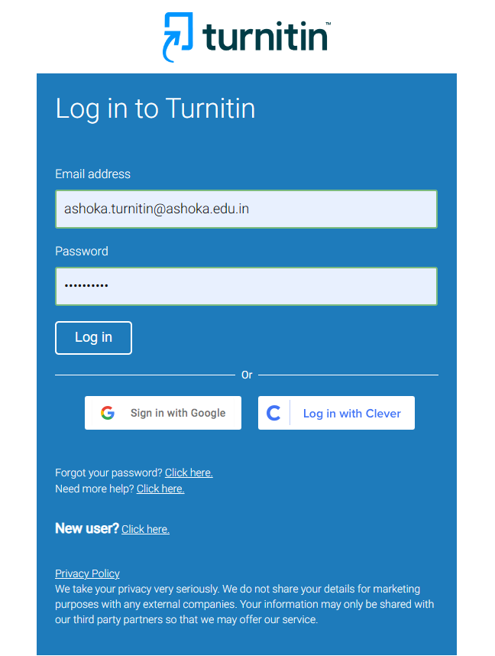



Visit Turnitin website: www.Turnitin.com
Input your credentials here
Click to Login

Slide 3

Creating a class
Class type - choice between "Standard" and "Master". For a regular class with one instructor, select "Standard".
Class name - The class name will appear on instructor and student homepages. It can be between 2 and 300 characters long.
Enrollment key - The enrollment key is typically created by the instructor and must be between 4 and 20 characters long. Students use this enrollment key to join the class on Turnitin after it's created. Instructor can view or change your enrollment key by editing the class.
Subject area(s) The dropdown provides several options, and Instructor may select more than one (clicking the "x" next to a selection will remove it). Choose "Other" if you don't find your subject area in the list.
Student level(s) Instructor can select more than one. Clicking the "x" next to a selection will remove it.

Slide 4
Adding a Master Class
1. Click on Add Class
use the class type: drop-down menu and select Master class.
Enter the following information:
  Master class name - The master class name will appear on instructor homepages. It can be between 2 and 300 characters long.
  Subject area(s) The dropdown provides several options, and you may select more than one (clicking the "x" next to a selection will remove it). Choose "Other" if you don't find your subject area in the list.
  Student level(s) e.g. postgraduate - You can select more than one. Clicking the "x" next to a selection will remove it.
Select the end date for the master class.
Use the Submit button and a new master class will be created. When first created, a master class will not have any sections.

Slide 5
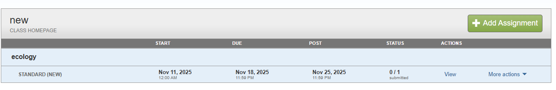
Adding assignments in Class
Click the "Add assignment" button to add an assignment to your class homepage. Click an assignment's "View" button to view the assignment inbox and any submissions that have been made to the assignment.

Slide 6
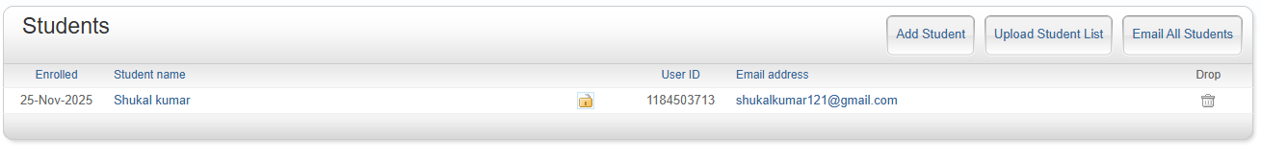
Adding Student in Class
Student can be added by
Add Student – In this option a Instructor can add user one by one by adding the fields – First name, Last name and email Id
Uploading User List – In this a Instructor can add multiple students by uploading a single file. Please note the file will be in csv format. The following fields are mandatory for the uploading a user list – First name, Last name and Email ID.
Email All Student – for sending the email to all registered student of a class.

Slide 7
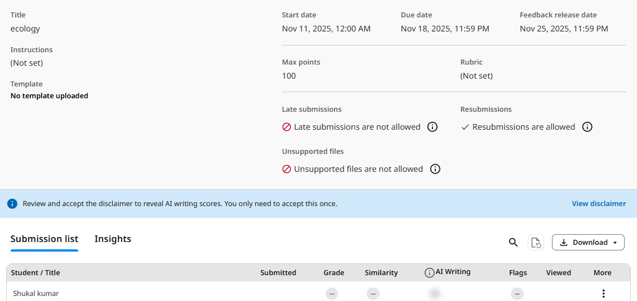
Checking the Similarity Report

Slide 8
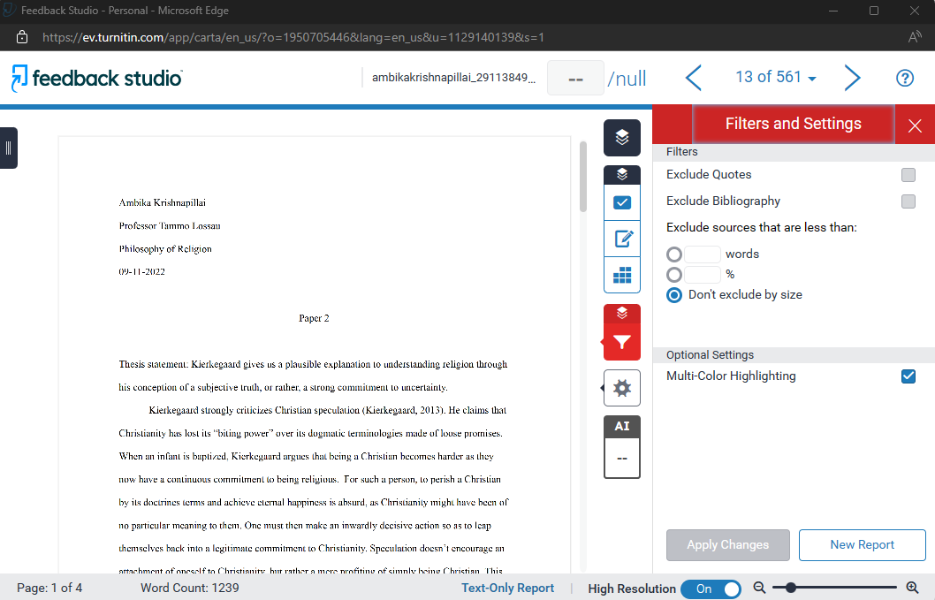
You can apply your filter and setting to exclude things

Slide 9
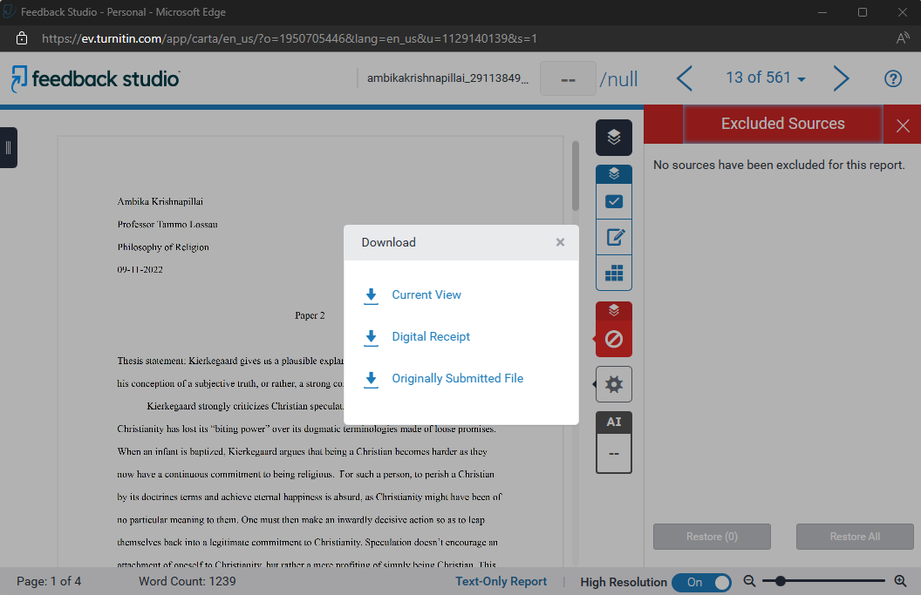
Download your similarity report
Click on Current View to download your report

