Slide 1
ProQuest Historical Newspapers: The Times of India
Sanjay Rajan, Sr. training & Consulting Partner – EMEAI, ProQuest

Slide 2
ProQuest Historical Newspapers: The Times of India
“ProQuest Historical Newspapers: The Times of India” provides genealogists, researchers and scholars with online, easily-searchable first-hand accounts and unparalleled coverage of the politics, society and events of the time.
To access the “ProQuest Historical Newspapers: The Times of India ” , either you can go through your Ashoka University library website or you can use the direct link of ProQuest search page https://search.proquest.com

Slide 3
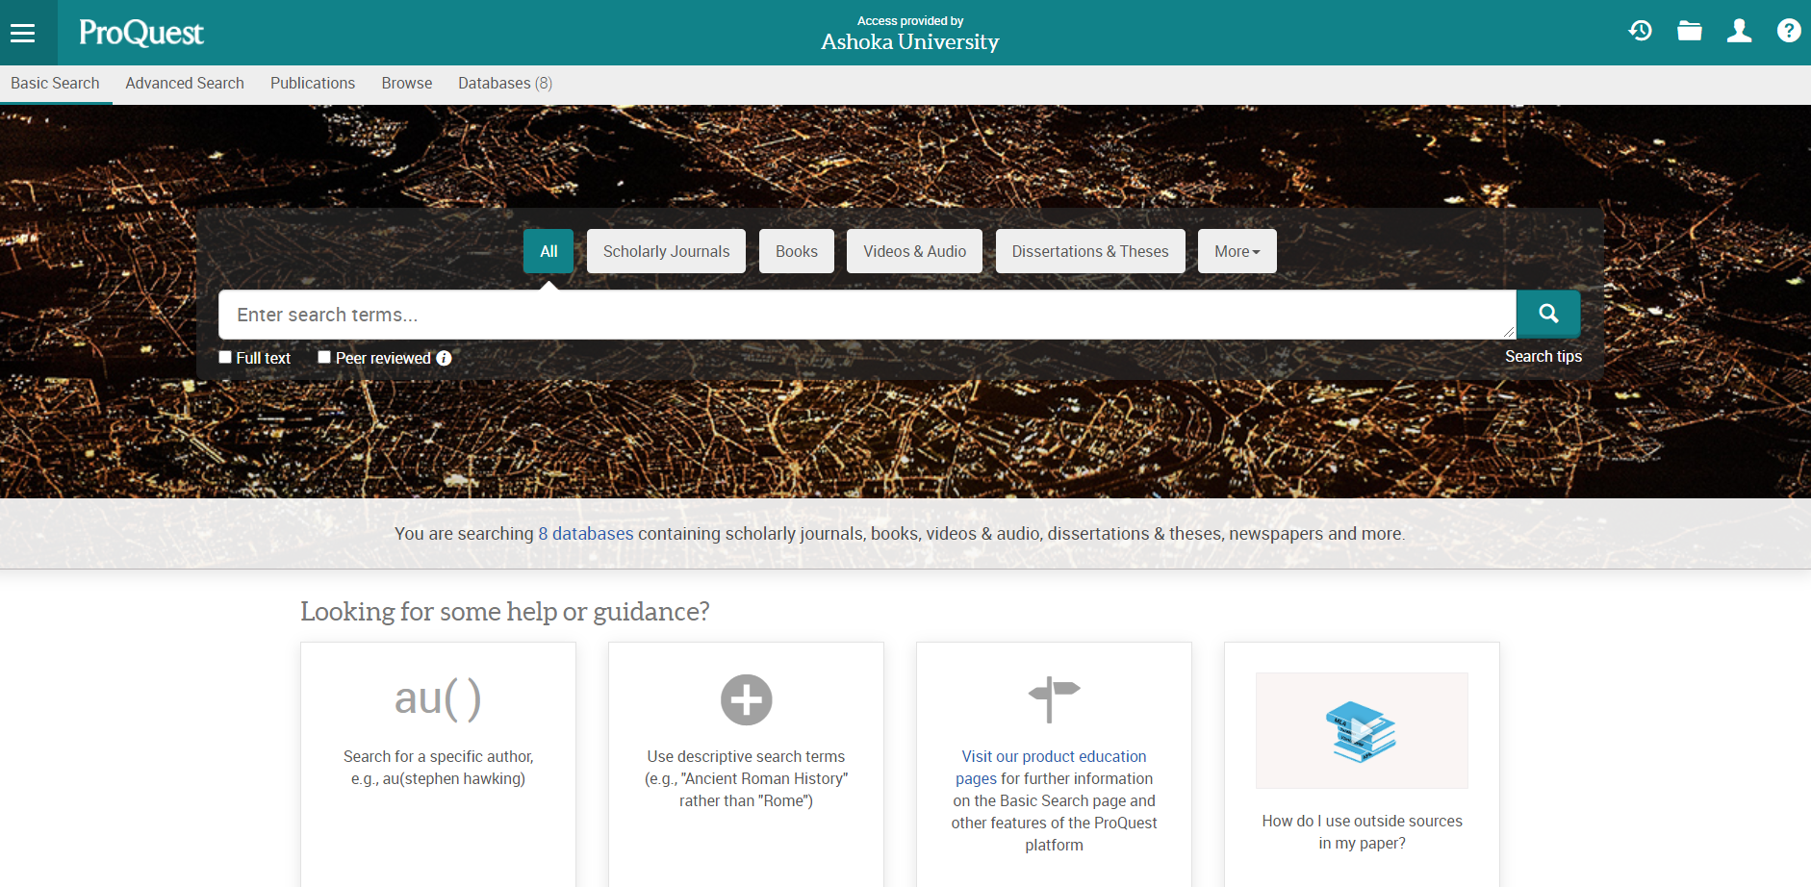
ProQuest Home Page
Use the URL https://search.proquest.com (or URL provided by library )
Click on Databases tab

Slide 4
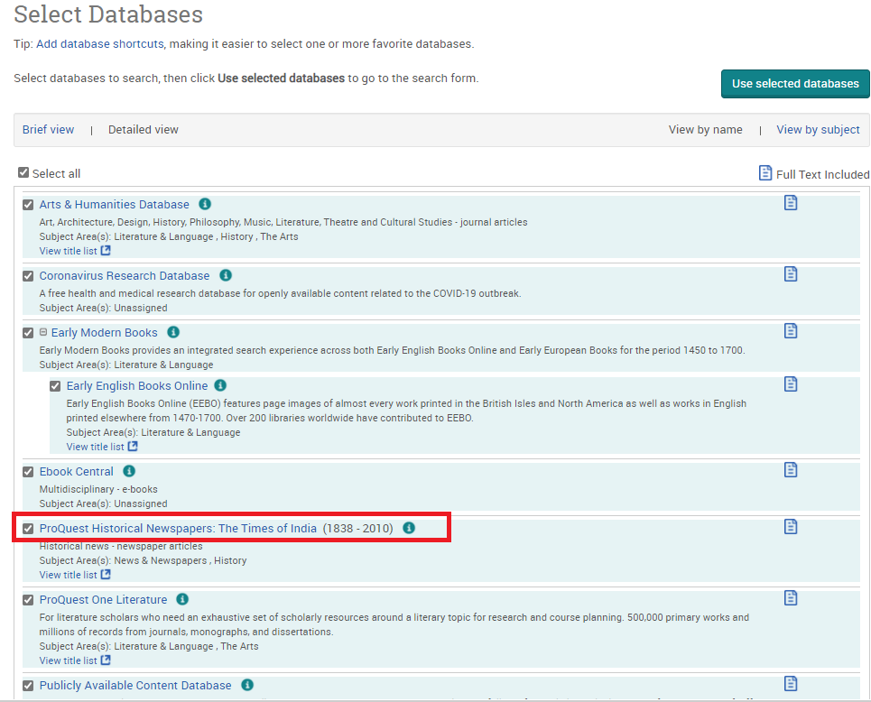
List of Subscribed ProQuest Databases
After clicking on Databases Tab, list of subscribed databases page will appear
User can select “ProQuest Historical Newspapers: The Times of India” database and click on the title link

Slide 5
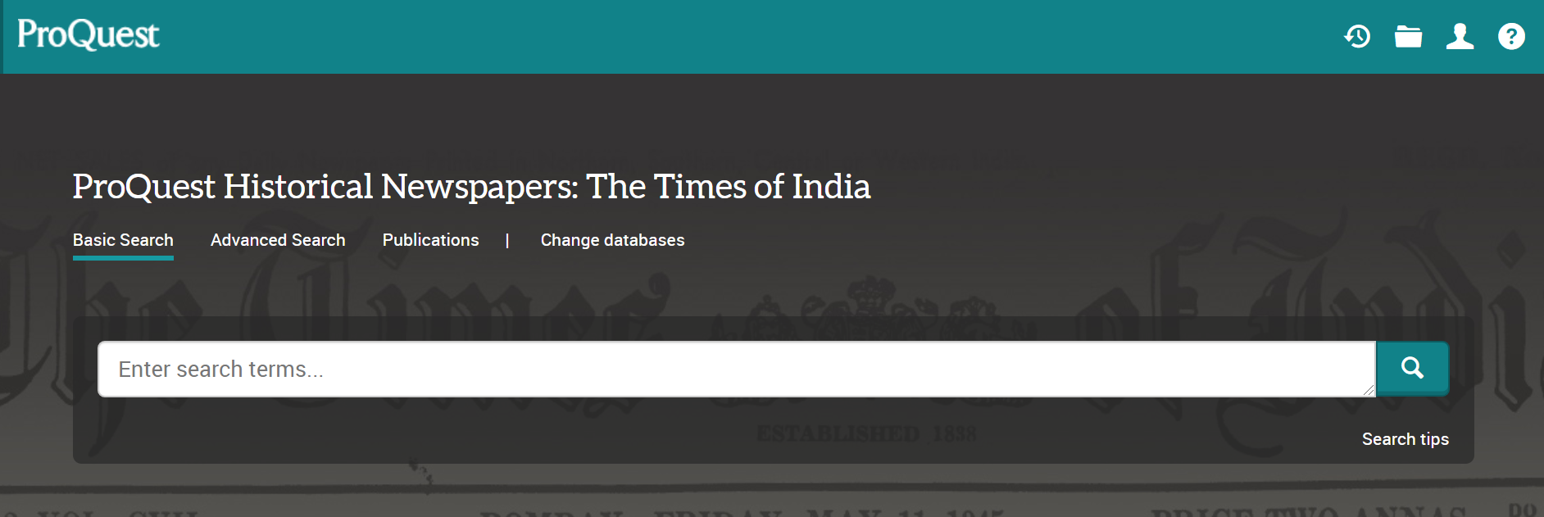
Home Page
You will land on the home page of “ProQuest Historical Newspapers: The Times of India” from where you can start to search

Slide 6
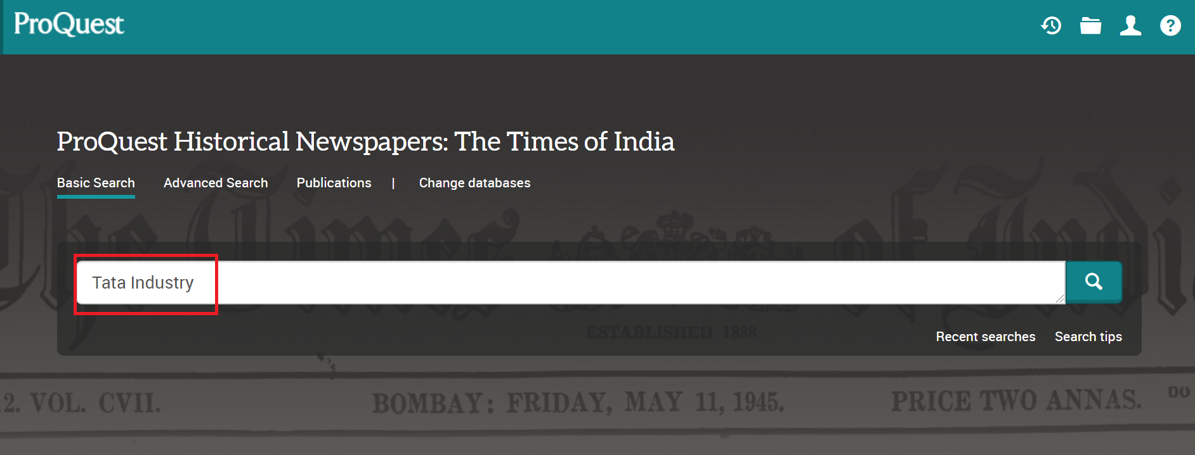
Start to Search
Now, you can start to search the database by entering any keywords in the search box and then click the search button

Slide 7
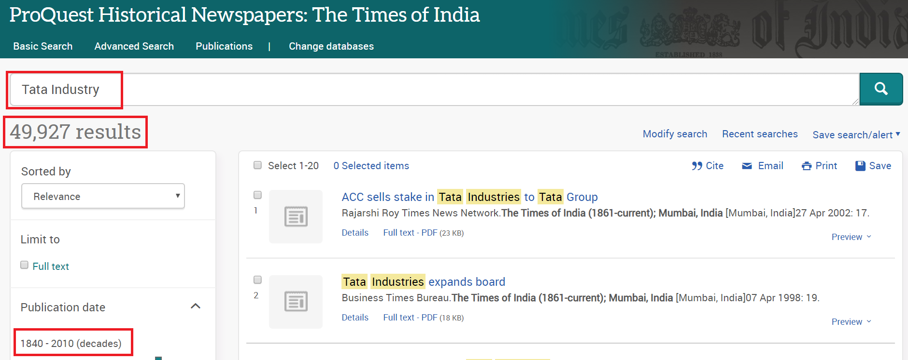
Result Page
You will land on the result page, where you have access to several more tools to refine the search, display the results, download them, etc.
You can preview any documents in the result page by clicking on the Preview button next to each record

Slide 8
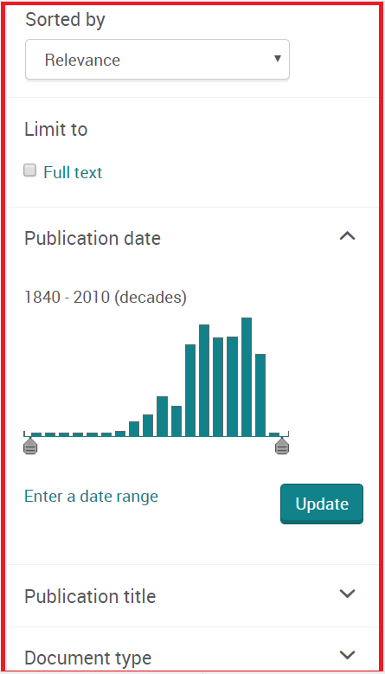
Filter the Records
You can narrow down your search by using multiple filter options such as Publication Date, Publication Title Document Type etc., as found on the left-hand side of the results page

Slide 9
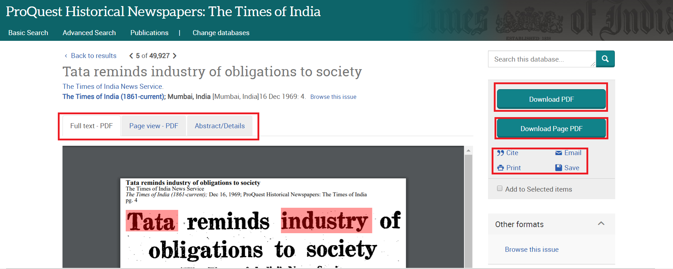
Download
To read and download the full text of any document, just click the title of any record and then click on Download PDF
To generate the citation of relevant document, just click the Cite button
To share the link of any document, just click the Email button and enter the email id of the person(s) with whom you want to share the link of the document

Slide 10
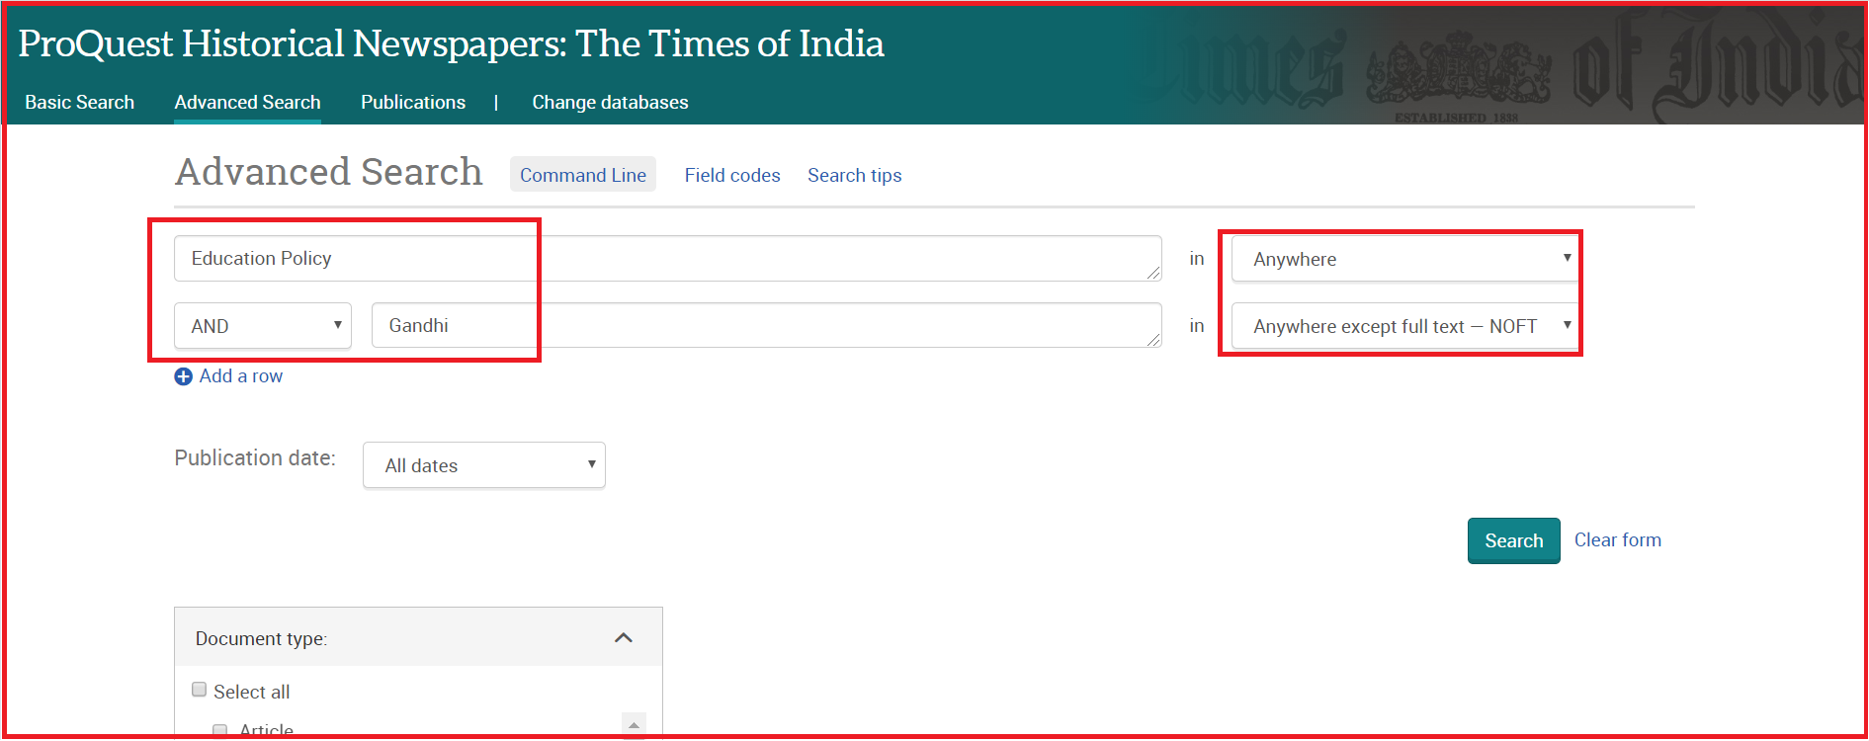
Advanced Search
For a more precise search, you can use Advanced Search to select more refined criteria with the help of search fields, Boolean operators and other available options

Slide 11
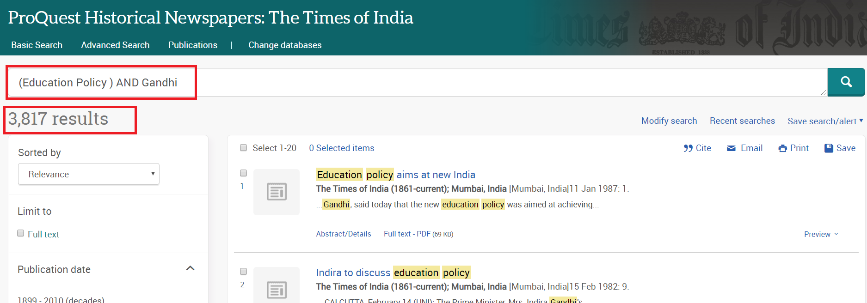
Advanced Search Results
You will get more precise results in advanced search

Slide 12
Additional Resources
Libguides : http://proquest.libguides.com/hnp/about
Product Information: https://about.proquest.com/products-services/pq-hist-news.html
Upcoming Webinars: https://about.proquest.com/company/webinars.html
Brochure: https://media2.proquest.com/documents/hnp_india.pdf

Slide 13
Thanks!!
Email
sanjay.rajan@proquest.com
Mobile
9654355648

